Slide 1
A Basic Understanding of Coarse and Fine Counter

Slide 2
Time to Digital Converter(TDC)
A time to digital converter measures the time-interval between two pulses and returns the time difference as a digital output code.
The minimum value of time difference that a TDC can measure is known as the resolution of TDC.
TDCs have been used in the field of particle and high energy physics, where precise time-interval measurement is required.
In essence, one can consider a TDC as a high precision stop-watch.
A TDC consists of two parts : A Coarse counter and a Fine counter.

Slide 3
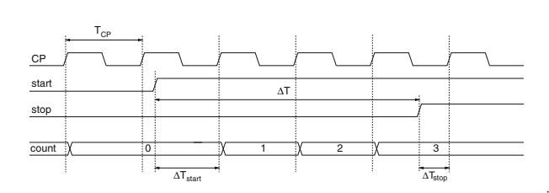
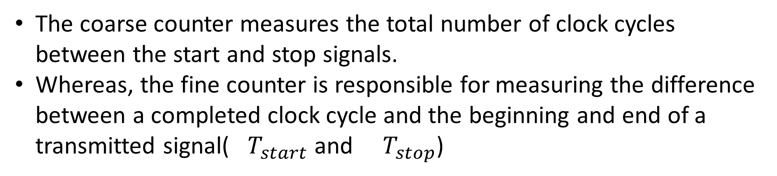
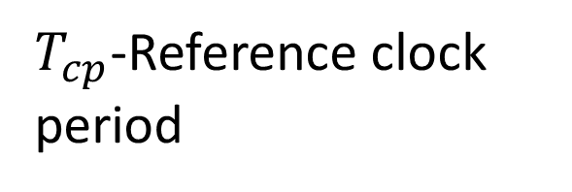
$T_{cp}$-Reference clock period
The coarse counter measures the total number of clock cycles between the start and stop signals.
Whereas, the fine counter is responsible for measuring the difference between a completed clock cycle and the beginning and end of a transmitted signal( $T_{start}$ and $T_{stop}$)

Slide 4
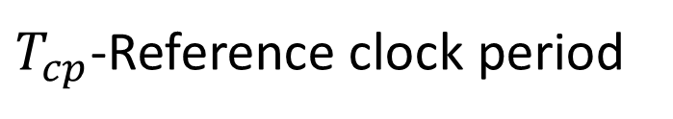
$T_{cp}$-Reference clock period

Slide 5
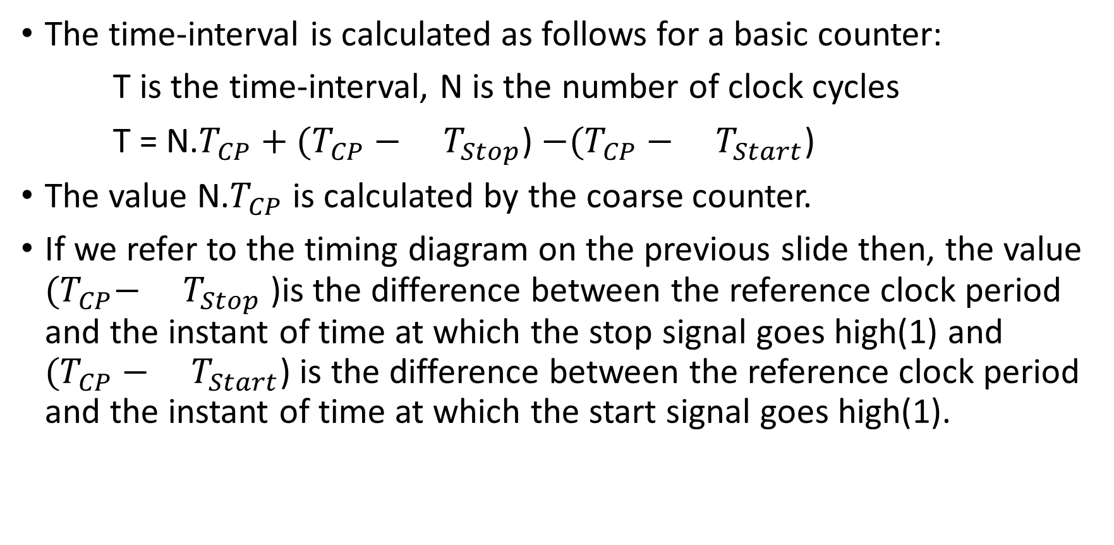
The time-interval is calculated as follows for a basic counter:
T is the time-interval, N is the number of clock cycles
T = N.$T_{CP}+(T_{CP}−$ $T_{Stop}$) $−(T_{CP}−$ $T_{Start}$)
The value N.$T_{CP}$ is calculated by the coarse counter.
If we refer to the timing diagram on the previous slide then, the value ${(T}_{CP}−$ $T_{Stop}$ )is the difference between the reference clock period and the instant of time at which the stop signal goes high(1) and $(T_{CP}−$ $T_{Start}$) is the difference between the reference clock period and the instant of time at which the start signal goes high(1).

Slide 6
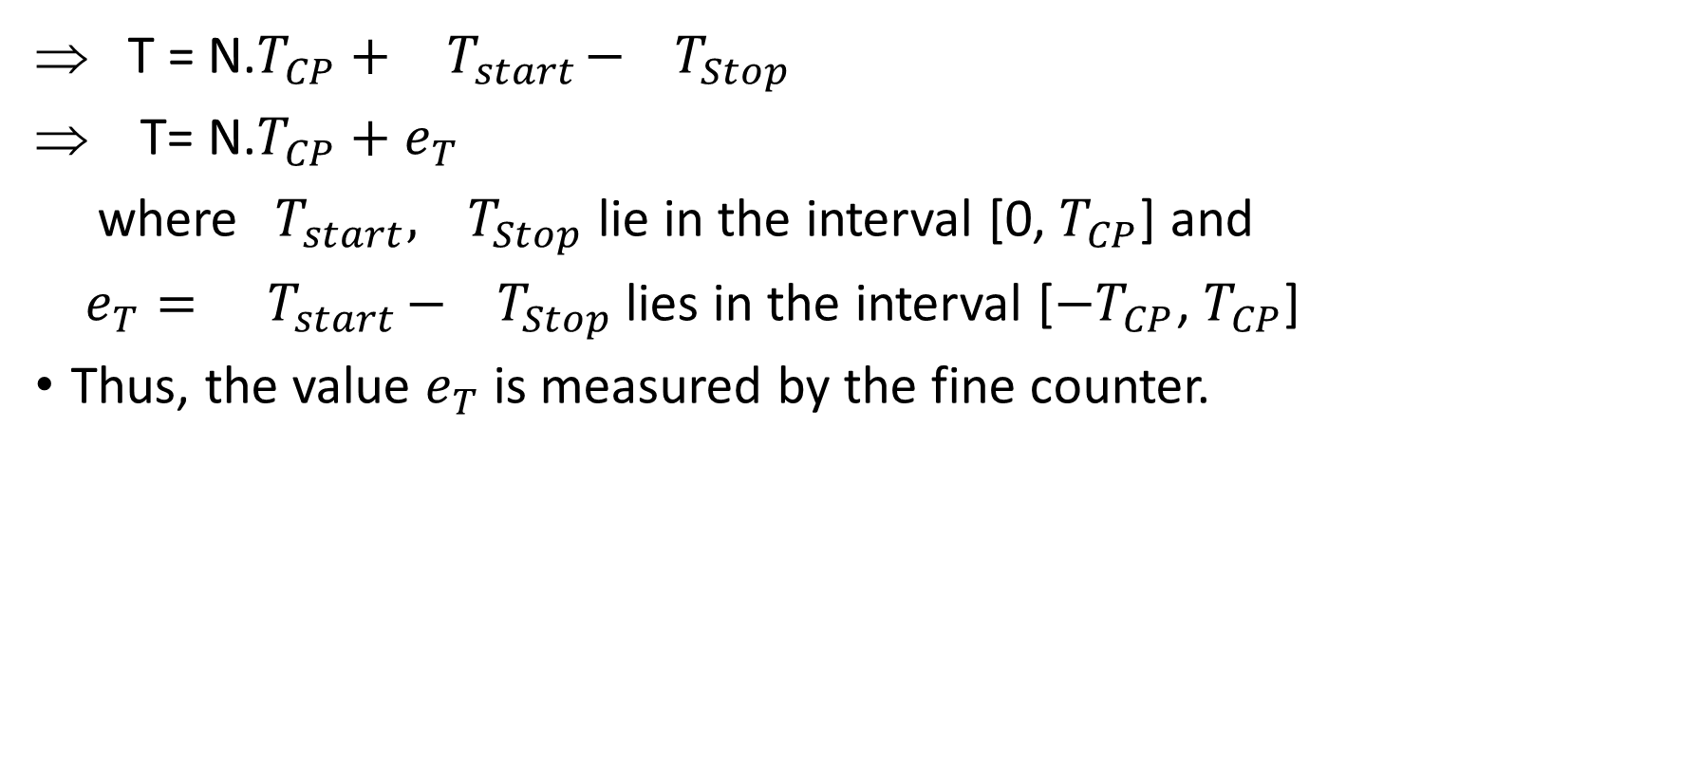
T = N.$T_{CP}+ { T}_{start}−{ T}_{Stop}$
T= N.$T_{CP}+e_{T}$
where${ T}_{start},{ T}_{Stop}$ lie in the interval [0, $T_{CP}$] and
$e_{T}= { T}_{start}−{ T}_{Stop}$ lies in the interval [${−T}_{CP}$, $T_{CP}$]
Thus, the value $e_{T}$ is measured by the fine counter.

Slide 7
An even higher resolution maybe achieved by subdividing one clock period asynchronously into smaller time intervals.
The engine that performs the above sub-division is what we call a digital time-to-digital converter.
Basically, resolution is the criterion that distinguishes a counter from a TDC.

Slide 8
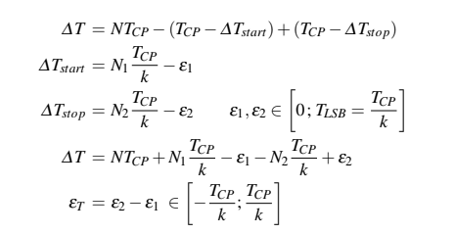
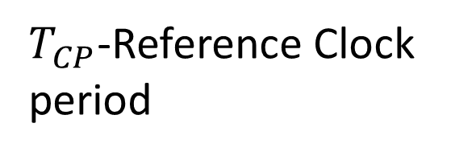
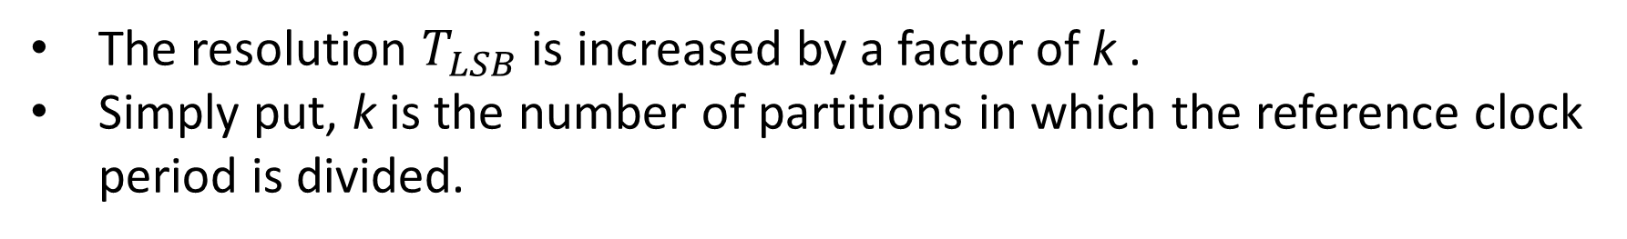
$T_{CP}$-Reference Clock period
The resolution $T_{LSB}$ is increased by a factor of k .
Simply put, k is the number of partitions in which the reference clock period is divided.

Slide 9
Summary
The coarse counter can measure a greater range of values.
However, the resolution of the coarse counter is low.
In essence, the range of values that can be measured by the fine counter is low.
However, the resolution of the fine counter is high.

